Slide 1

PROJECT :- Job Market Analysis and Recommendation System
Name:- AMAN SHARMA

Slide 2


Slide 3
OBJECTIVES AND SITUATIONAL OVERVIEW
The primary objective of this project is to analyze job market trends and build a recommendation system for job seekers based on real-time data. The system will help in identifying high-demand job roles, salary trends, and emerging job categories, and will provide personalized job recommendations.
The job market is dynamic and influenced by various factors including technological advancements, economic shifts, and cultural trends. This project aims to harness the power of data analytics to understand these dynamics and provide actionable insights through a recommendation system. By analyzing historical and current job postings data, the project will provide predictions and recommendations that help job seekers and recruiters make informed decisions.

Slide 4
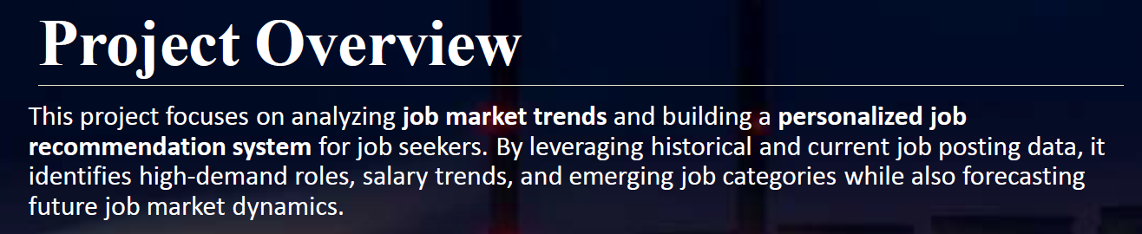


Slide 5
STEPS IN SUMMARIZING THE DATA PROCESS
Task 1: Analyze the correlation between job title keywords and offered salaries
Task 2: Identify emerging job categories based on posting frequency
Task 3: Predict high-demand job roles by analyzing job posting patterns over time
Task 4: Compare average hourly rates across different countries
Task 5: Create a job recommendation engine based on current job postings
Task 6: Track changes in job market dynamics over months
Task 7: Investigate trends in the remote work landscape
Task 8: Predict future job market trends

Slide 6
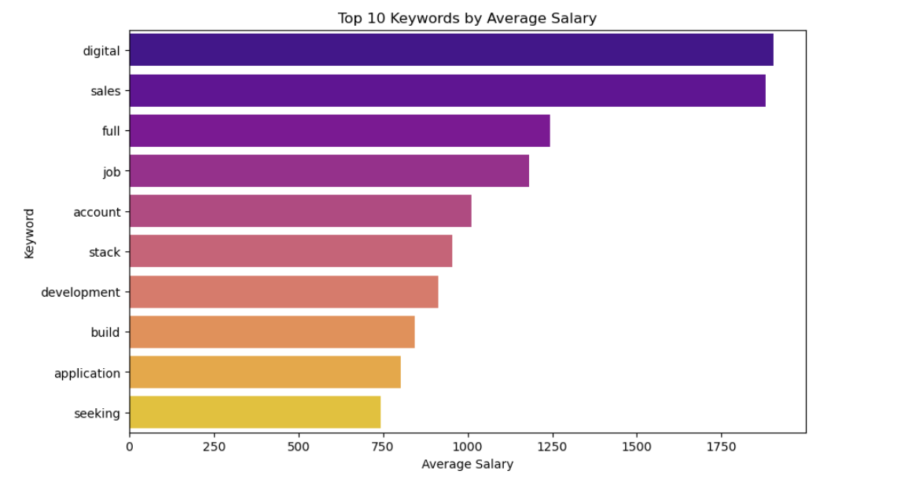
Task 1.1: job titles and the corresponding salaries offered.

Slide 7
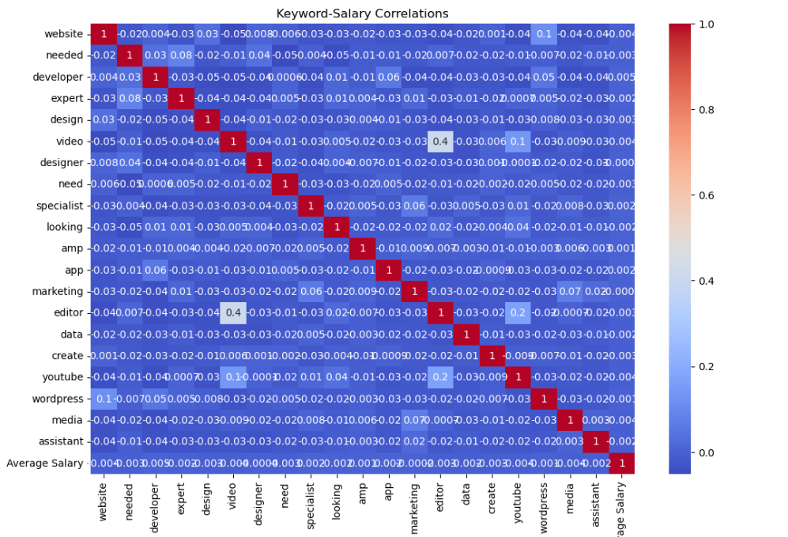
Task 1.2 : Detaile the correlation, supported by statistical analysis and visualizations.

Slide 8
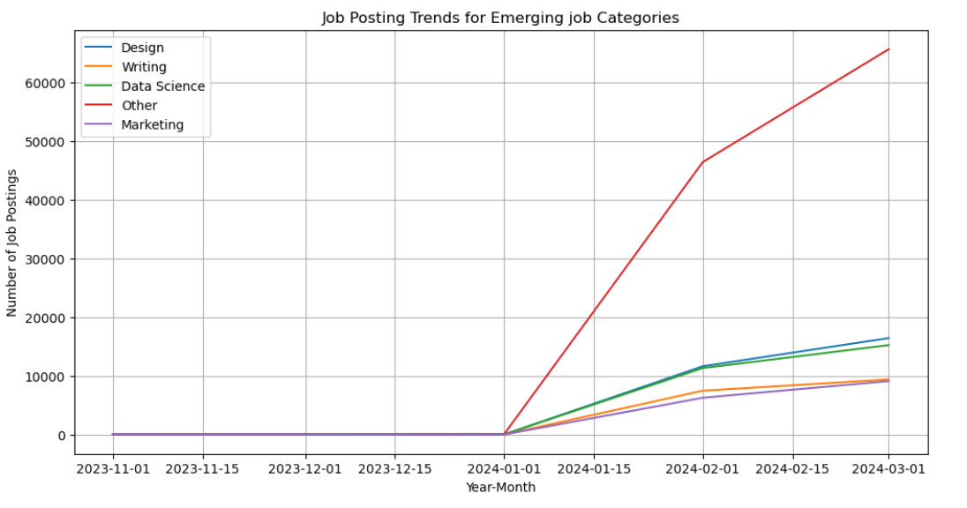
Task 2.1: job categories by analyzing the frequency and trend of job postings.

Slide 9
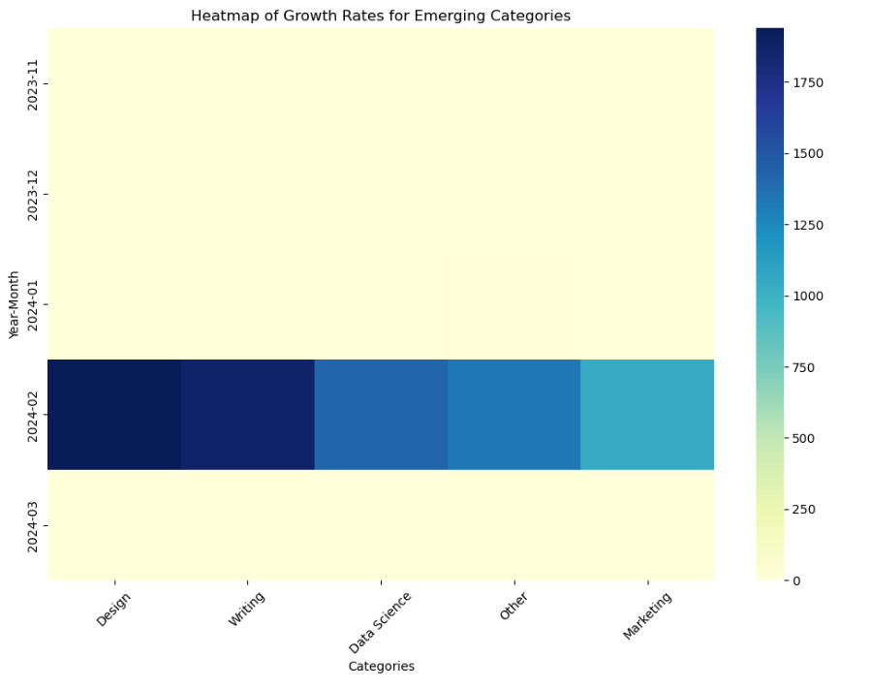
Task 2.1: A list of emerging job categories with growth analysis over time.

Slide 10
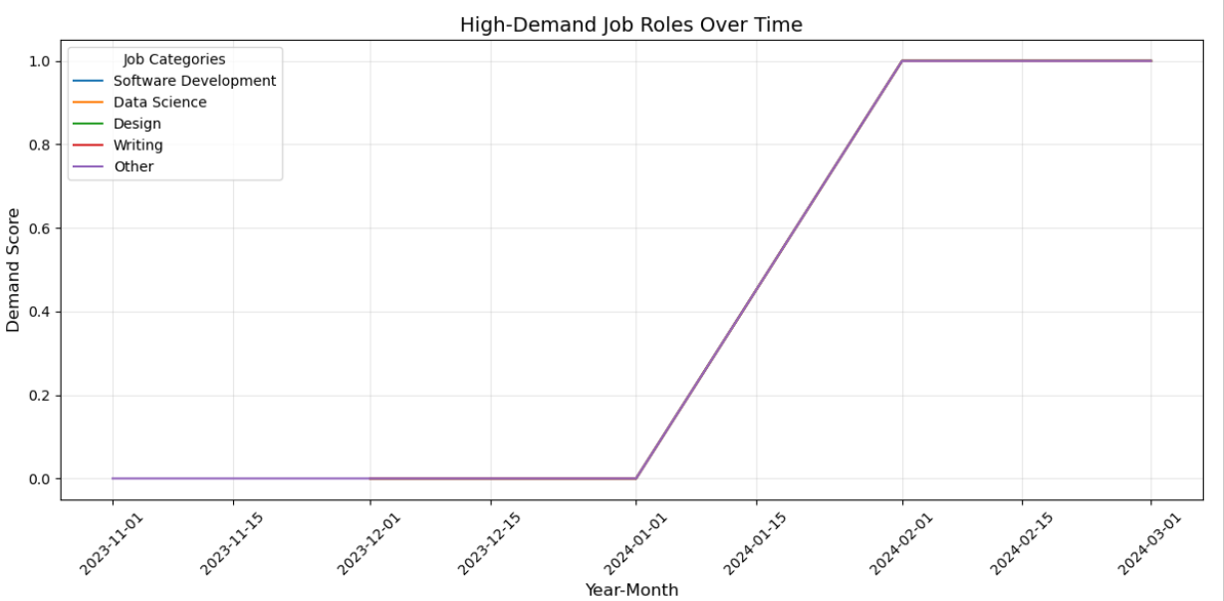
Task 3.1: high-demand job roles based on historical job posting data.

Slide 11

Task 3.2 : Visual representation of demand trends over time.
Visual trends over time refer to the popular styles and patterns in graphic design, data visualization, and other visual fields that change and evolve across different eras and platforms

Slide 12
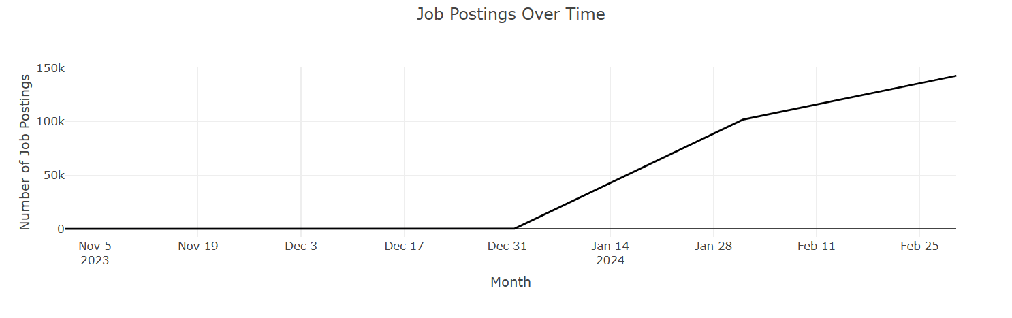
TASK : 4.1 To monitor and track the changes in job market dynamics.

Slide 13
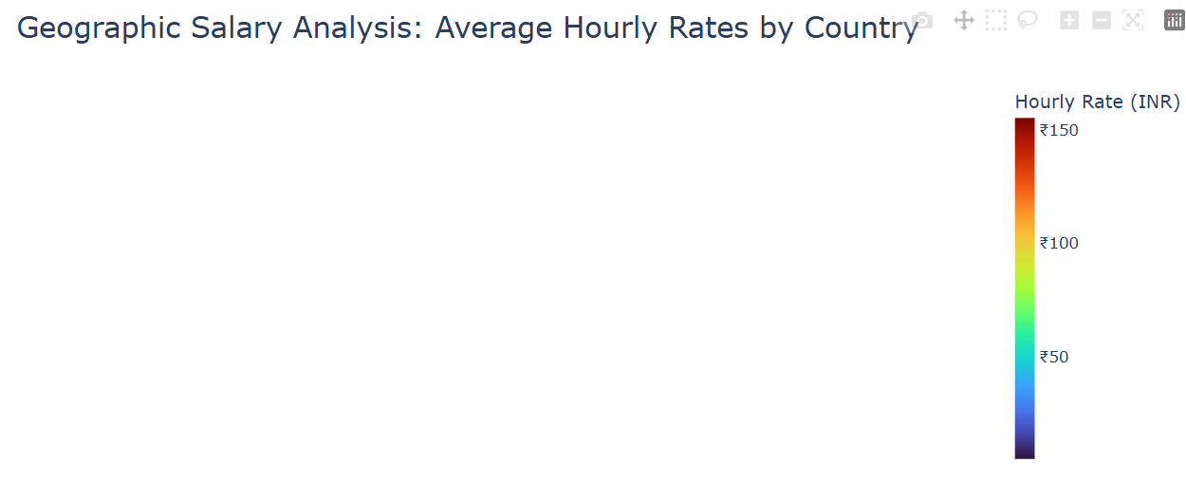
TASK : 4.1 :An interactive map or chart showing hourly rates by country.
An interactive map showing hourly rates by country is a dynamic data visualization that typically uses color or size to represent hourly labor costs, allowing users to click on regions or countries to see specific data, filter results, and compare costs across different locations. Examples of platforms that provide such data include Eurostat for EU labor costs, the Global Living Wage Coalition for living wages, and TheGlobalEconomy.com for worldwide labor costs.

Slide 14
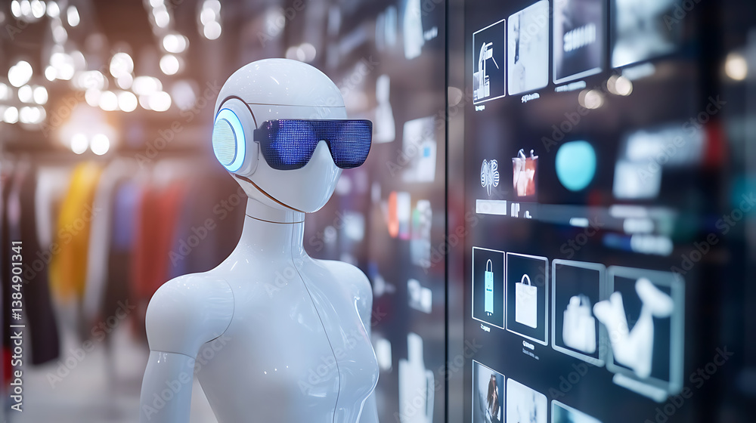

JOB RECOMMENDATION ENGINE
A recommendation engine, also called a recommender, is an artificial intelligence (AI) systemthat suggests items to a user. Recommendation systems rely on big data analytics and machine learning (ML) algorithms to find patterns in user behavior data
and recommend relevant items based on those patterns.

Slide 15
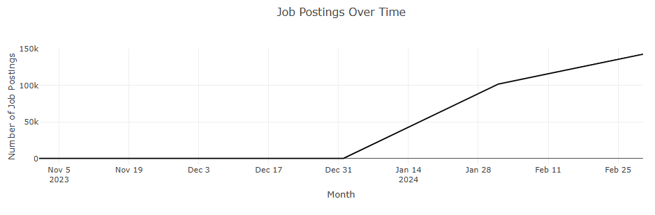
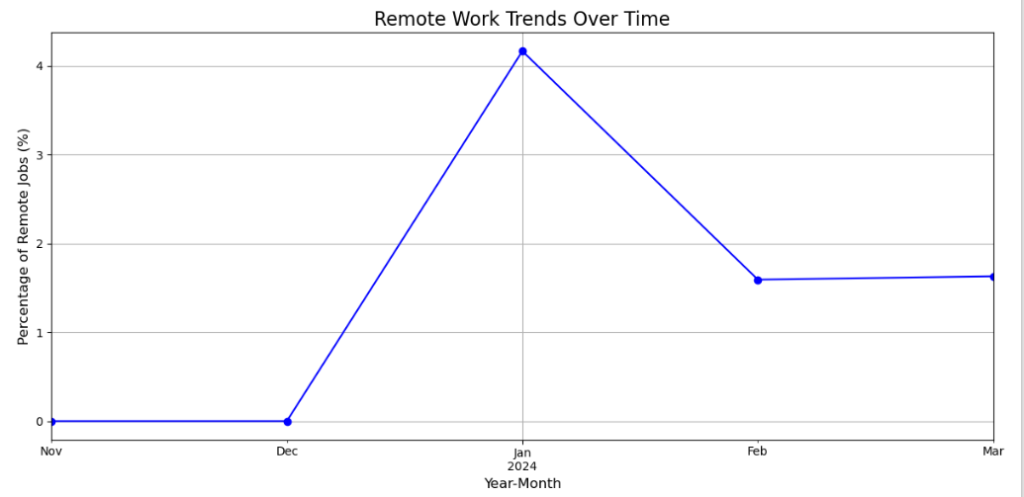
Task 6.1,6.2: Changes in Job Market Dynamics , New Trends in the Job Market

Slide 16
Remote Work Landscape
Insights
Remote Job Trends by Category
Sales and Finance categories saw a dramatic surge in remote job ratios in Jan 2024, peaking above all other categories.
Both categories experienced a steep drop in remote job ratios by Feb 2024, suggesting either a return to hybrid/in-office roles or short-term remote contracts.
Education showed a gradual upward trend, indicating growing acceptance of remote teaching and learning roles.
Customer Support, Software Development, and Writing maintained consistent remote ratios, reinforcing their suitability for remote work.
Legal, Marketing, and Design had minimal remote ratio changes, possibly due to role-specific collaboration needs or slower remote adoption.
Project Management & Other Roles:
These categories showed moderate fluctuations, hinting at evolving remote policies or project-based flexibility.

Slide 17
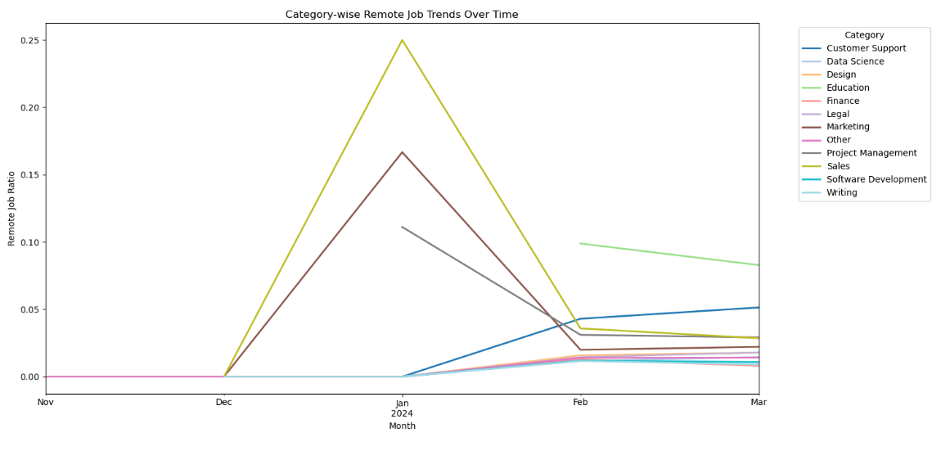

Slide 18
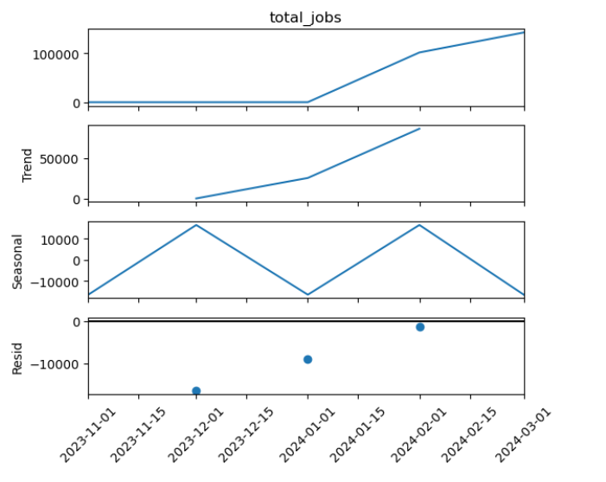
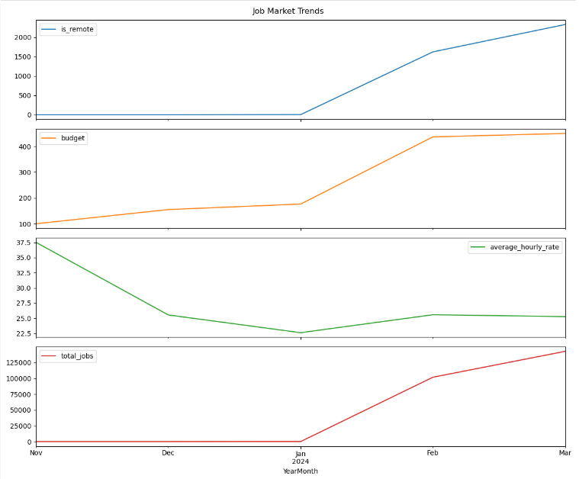
Job Market Trends

Slide 19

.
CONCLUSION !
This project successfully applies Python, SQL, Pandas, Scikit-Learn, and TensorFlow for machine learning models. to classify Visualization Tools: Matplotlib, Seaborn, Plot for interactive graphs.
Web Development: Flask or Django for API development.
Containerization: Docker for deploying and managing application containers.
Docker containers will be used to package the application with all its dependencies, ensuring consistency across development, testing, and production environments.
This project will provide a multi-faceted view into the job market through extensive data analysis and a recommendation system, encapsulated within a robust Docker environment for easy deployment and scaling. The deliverables will include detailed reports, predictive models, and a user-friendly web application, offering valuable insights and assistance to job seekers and industry analysts alike.

Slide 20

THANK YOU

